Slide 1
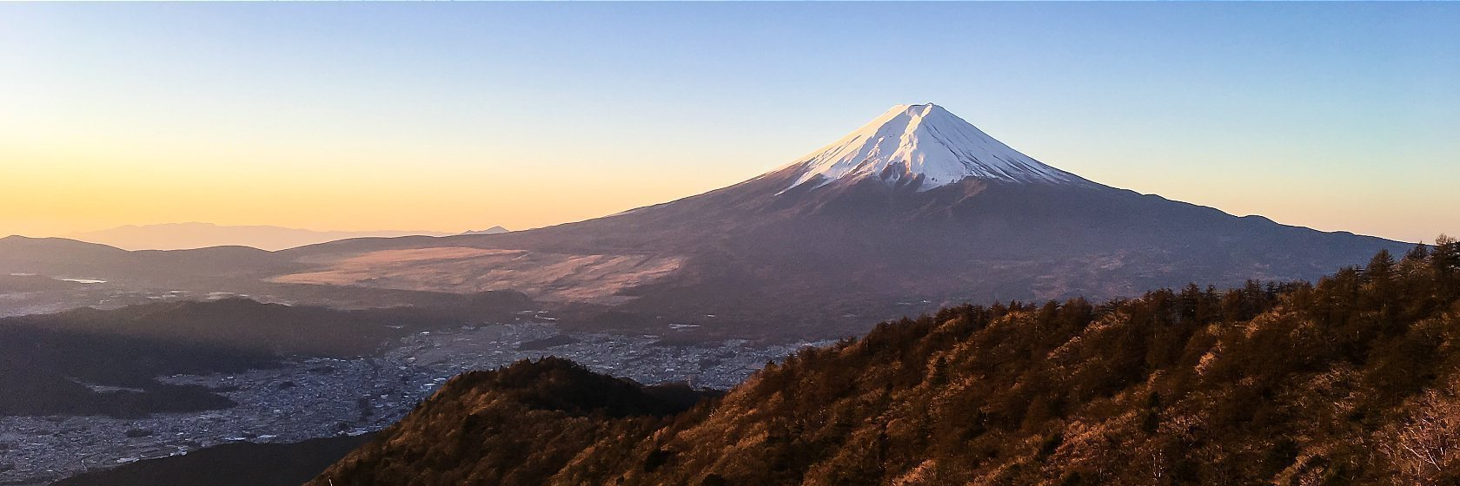
Tokyo Airbnb Analysis 2019-2020
Tony Li
Thinkful Data Analytics

Slide 2
Introduction
There is increasing demand on Airbnb housings because of these advantages: (1) Live in a space like home; (2) Interact with local host for better travel tips; (3) Spend less money than staying in standard hotels.
Help travelers navigate the district and neighborhood to book for better experience

Slide 3
Driving Factors of Listing Price
Location: Average price in different districts and neighborhoods can be significantly different.
Room Type: Entire Unit, Private Room, or Shared Room
Cancellation Policy: Strict 14 days with grade period, Moderate or Flexible

Slide 4
Analysis Area
Top 10 Districts for Comfort Travel & Top 10 Districts for Budget Travel;
Top 3 Districts of Both Travel Types over the Year;
Top 10 Ideal Neighborhood by Zip Code for Both Travel Types;
Available Neighborhood in Top 8 Tourist Spot;
Top 20 Hosts in Tokyo with Worry Free.

Slide 5
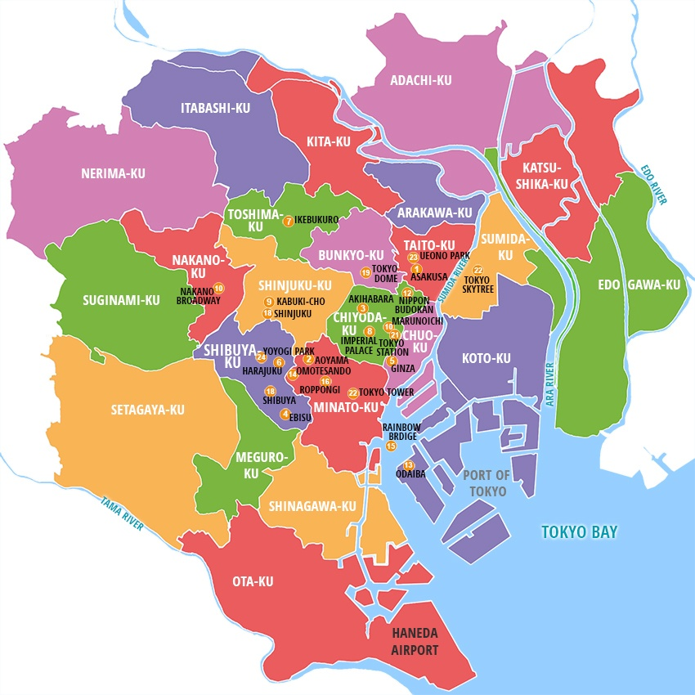
Tokyo Districts

Slide 6
Top 10 Districts for Comfort Travel
Comfort Travel: Private Room and Entire Unit as room type
Filter: (1) Overall ≥ 93; (2) Value ≥ 9.3; (3) # Listing ≥ 1000.
District (Ku) | # Listing | Overall Rating | Value Rating | Average Price (JPY)
Chuo Ku | 2894 | 95 | 9.3 | 29,100
Ota Ku | 5441 | 94 | 9.4 | 11,500
Setagaya Ku | 3024 | 94 | 9.3 | 13,100
Katsushika Ku | 2607 | 94 | 9.4 | 13,700
Nakano Ku | 3324 | 94 | 9.3 | 17,600
Arakawa Ku | 2044 | 94 | 9.3 | 13,300
Kita Ku | 2113 | 93 | 9.3 | 13,200
Koto Ku | 1394 | 93 | 9.3 | 12,900
Itabashi Ku | 2498 | 93 | 9.4 | 14,700
Suginami Ku | 3002 | 93 | 9.3 | 11,500

Slide 7
Top 10 Districts for Budget Travel
Budget Travel: Shared Room as room type
Filter: (1) Overall ≥ 93; (2) Value ≥ 9.3; (3) # Listing ≥ 30.
District (Ku) | # Listing | Overall Rating | Value Rating | Average Price (JPY)
Shinagawa Ku | 146 | 98 | 9.7 | 3,000
Arakawa Ku | 118 | 98 | 9.7 | 5,100
Nakano Ku | 33 | 98 | 9.8 | 3,000
Meguro Ku | 56 | 98 | 10.0 | 2,500
Suginami Ku | 132 | 97 | 9.8 | 3,300
Setagaya Ku | 61 | 97 | 9.3 | 4,100
Ota Ku | 91 | 96 | 9.8 | 4,300
Sumida Ku | 478 | 96 | 9.8 | 2,500
Itabashi Ku | 63 | 94 | 9.6 | 2,500
Taito Ku | 797 | 94 | 9.7 | 3,700

Slide 8
Top 3 Districts Price Change by Month
Use boxplot to show how the price changes throughout the year.
Comfort Travel: Chuo, Ota, Setagaya
Budget Travel: Shinagawa, Arakawa, Nakano

Slide 9
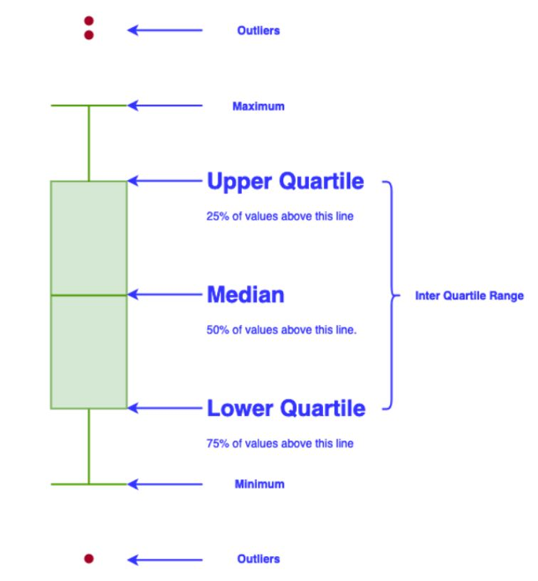
Boxplot Overview

Slide 10
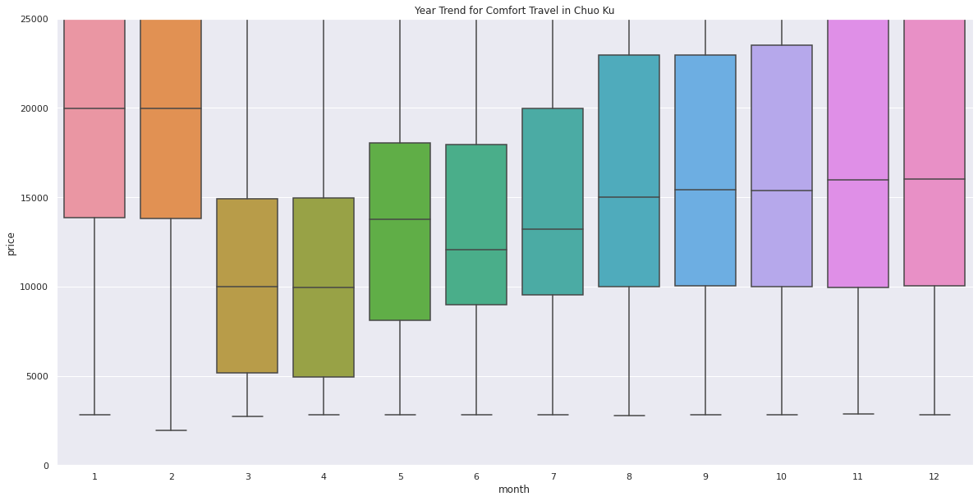
Comfort: Chuo Ku

Slide 11
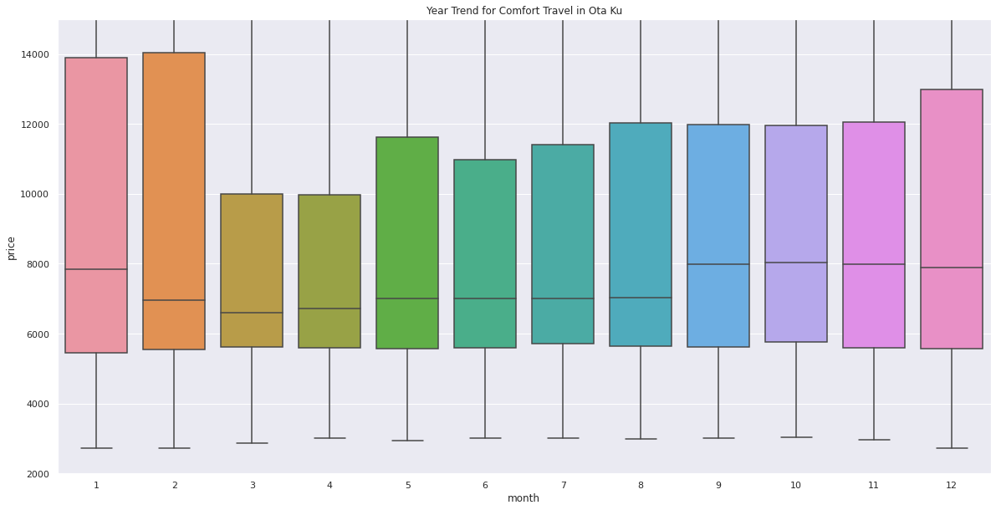
Comfort: Ota Ku

Slide 12
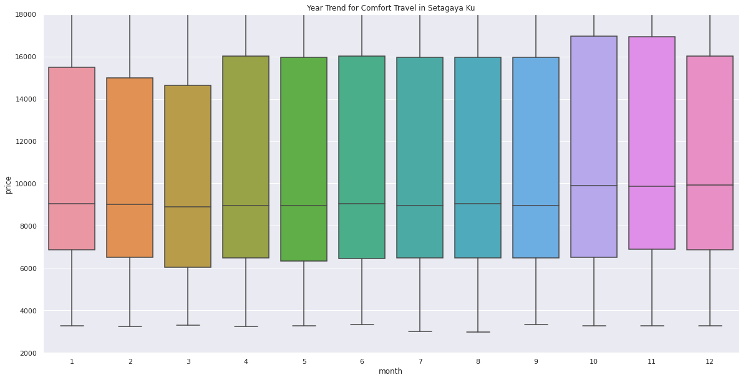
Comfort: Setagaya Ku

Slide 13
Boxplot for Budget Travel
The number of listing per month is less than 10.
The fluctuation of the median price is within 1000 yen ($10) along the year.

Slide 14
Neighborhood Navigation by Zip Code
Each district can have many neighborhoods with unique Zip Code.
Using zip code to narrow down can return these neighborhoods with higher ratings.
Zip code can be used to check the safety through Tokyo Crime Map.
Notes:
Each district can have many neighborhoods with unique zipcode. There might be some bad neighborhood dragging down the rating in a district. Using Zipcode to narrow down can return these neighborhoods with higher ratings. Also, the rating can be used to check the safety through Tokyo Crime Map.(Would demonstrate in powerpoint presentation)

Slide 15
Top 10 Neighborhoods for Comfort Travel
Filter: (1) Overall ≥ 95; (2) Location ≥ 9.8; (3) # Listing ≥ 100.
Zip Code | # Listing | Location Rating | Overall Rating | Average Price (JPY)
111-0043 | 321 | 10.0 | 97 | 20,200
103-0012 | 252 | 9.9 | 98 | 14,800
104-0045 | 330 | 9.9 | 98 | 13,700
141-0021 | 144 | 9.9 | 97 | 34,500
104-0042 | 122 | 9.9 | 97 | 21,300
105-0001 | 142 | 9.9 | 96 | 17,800
130-0012 | 209 | 9.9 | 96 | 14,400
107-0062 | 155 | 9.9 | 95 | 25,400
130-0002 | 681 | 9.9 | 95 | 15,700
105-0003 | 182 | 9.9 | 95 | 27,000

Slide 16
Top 10 Neighborhoods for Budget Travel
Filter: (1) Overall ≥ 95; (2) Location ≥ 9.5; (3) # Listing ≥ 25.
Zip Code | # Listing | Location Rating | Overall Rating | Average Price (JPY)
142-0064 | 36 | 10.0 | 97.9 | 3,400
144-0033 | 39 | 10.0 | 96.0 | 6,200
155-0031 | 45 | 10.0 | 95.8 | 4,400
160-0006 | 55 | 10.0 | 95.4 | 3,300
111-0051 | 87 | 9.8 | 97.8 | 5,800
111-0035 | 60 | 9.8 | 96.0 | 3,900
171-0031 | 48 | 9.8 | 95.5 | 3,500
130-0005 | 198 | 9.7 | 96.5 | 1,800
131-0045 | 32 | 9.6 | 98.1 | 4,600
165-0034 | 36 | 9.6 | 97.3 | 3,300

Slide 17
Top 8 Popular Tourist Spots
Tsukiji Outer Market
The Imperial Palace
Akihabara Junk Street
Senso-ji Temple
Hachiko Statue
Meiji Jingu
Yebisu Beer Memorial Hall
Roppongi Hills

Slide 18
Neighborhoods in Top 8 Tourist Spots
Only 4 neighborhoods with the same zip codes as these 8 popular tourist spots.
The number of Shared Room listings is negligible. Thus, it is for comfort travel.
Zip Code | # Listing | Location Rating | Overall Rating | Average Price (JPY)
104-0045 | 330 | 9.9 | 98 | 13,700
101-0021 | 155 | 9.9 | 95 | 19,800
150-0043 | 1546 | 9.9 | 95 | 17,300
111-0032 | 1814 | 9.3 | 93 | 18,100

Slide 19
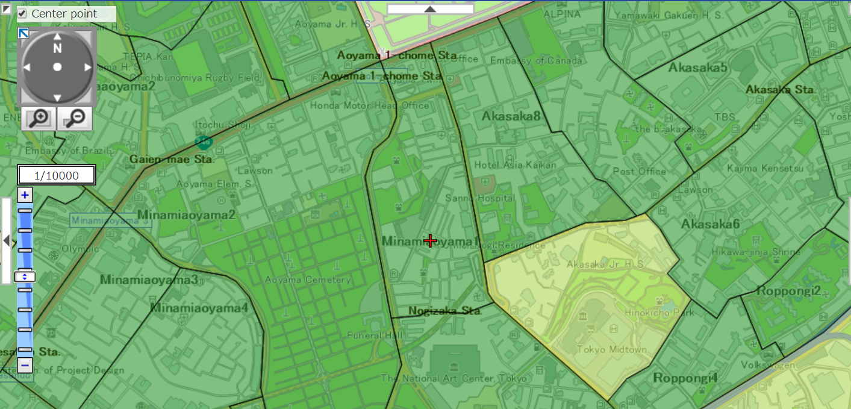
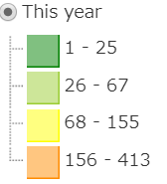
Crime Map
Good Neighborhood

Slide 20
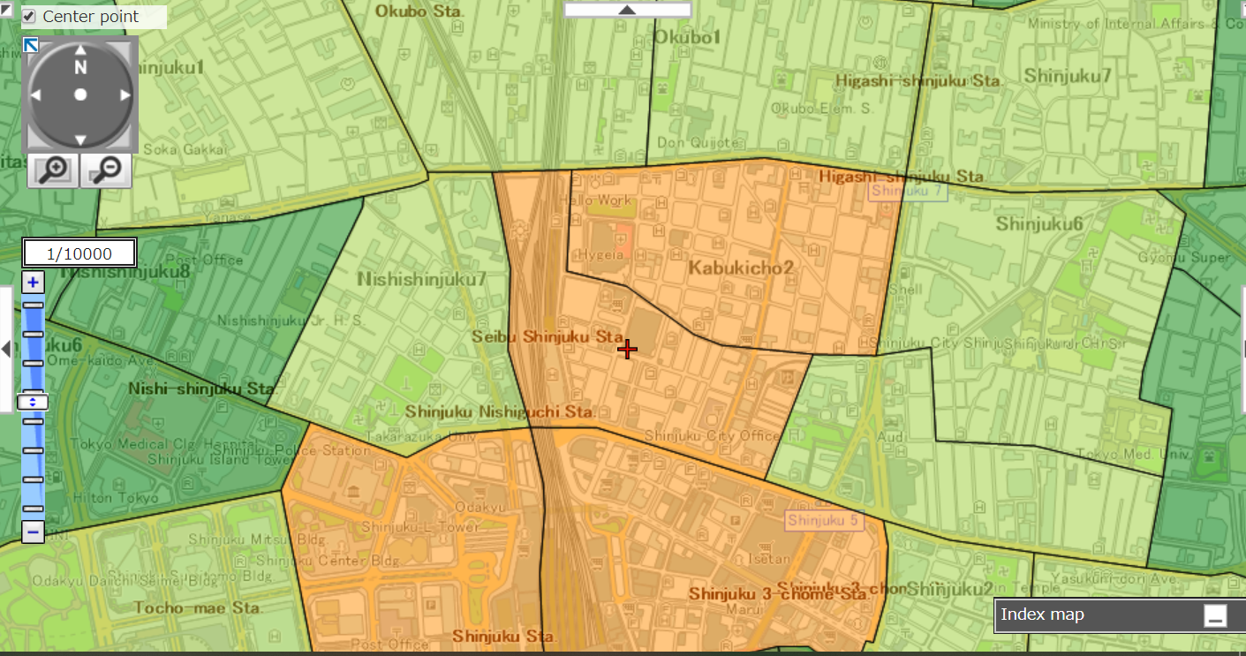
Crime Map
Bad Neighborhood

Slide 21
Top 20 Hosts in Tokyo with Worry-Free
Filter: (1) Overall ≥ 99; (2) Location ≥ 9.9
Sort by # Monthly Review.
Host ID | # Monthly Review
307553533 | 9.2
263773411 | 9.0
307091960 | 8.5
245921103 | 7.4
21004633 | 7.1
317903930 | 6.3
49376551 | 6.2
196974522 | 5.9
305651516 | 5.9
264883119 | 5.7
Host ID | # Monthly Review
54037182 | 5.6
289091075 | 5.4
296437224 | 5.4
47213138 | 5.4
69500395 | 5.1
145932895 | 5.1
160928809 | 5.1
196353318 | 5.0
318320103 | 5.0
299206258 | 4.9

Slide 22
Conclusion
With this analysis, the travelers can:
Determine the “most ideal” districts and neighborhoods by seeing the ratings, the # listing and the average price.
Access to the crime map to verify the nearby safety before making decision.
Find worry-free listings without locational preference.

Slide 23
Data Source
Airbnb Data in Tokyo from March 2019 to February 2020
Crime Map in Tokyo
Top 8 Tourist Spots in Tokyo

Slide 24
Thank you so much!
Wish you a great journey in Tokyo!

